Slide 1

HTML/CSS/JavaScript Training
Session 2 – HTML Implementation

Slide 2
HTML Elements
An HTML element is everything from the start tag to the end tag. "HTML tags" and "HTML elements" are often used to describe the same thing but an HTML element is everything between the start tag and the end tag, including the tags:
<p>This is a paragraph.</p>
Start Tag | Element Content | End Tag
<p> | This is a paragraph | </p>
<a href="default.htm"> | This is a link | </a>
<br>
<div> | <p>This is paragraph</p> | </div>
Nested HTML Elements
HTML Attributes

Slide 3
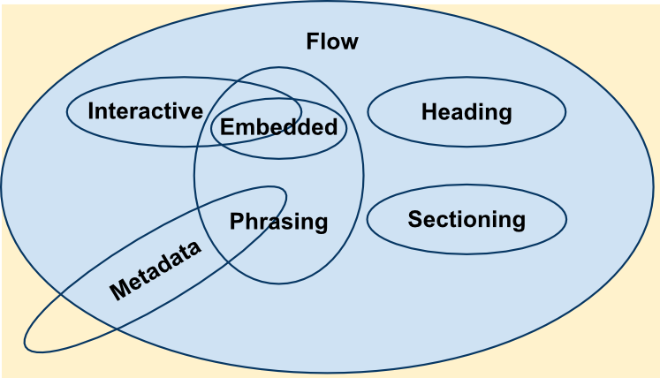
HTML Element Categories
Each HTML element must abide by rules defining what kind of content it can have. These rules are grouped into content models common to several elements. Each HTML element belongs to zero, one, or multiple content models, each settings rules that the element's content must follow in a HTML-conformant document.
There are three types of content categories:
Main content categories, which describe common content rules, shared by a lot of elements
Form-related content categories, which describe content rules common to form-related elements
Specific content categories, which describe rare categories, shared only by a few elements, sometimes only in a specific context.

Slide 4
HTML Element Categories
Metadata content
<base>, <command>, <link>, <meta>, <noscript>, <script>, <style> and <title>.
Flow content
<a>, <abbr>, <address>, <article>, <aside>, <audio>, <b>, <bdo>, <blockquote>, <br>, <button>, <canvas>, <cite>, <code>, <command>, <datalist>, <del>, <details>, <dfn>, <div>, <dl>, <em>, <embed>, <fieldset>, <figure>, <footer>, <form>, <h1>, <h2>, <h3>, <h4>, <h5>, <h6>, <header>, <hgroup>, <hr>, <i>, <iframe>, <img>, <input>, <ins>, <kbd>, <keygen>, <label>, <map>, <mark>, <math>, <menu>, <meter>, <nav>, <noscript>, <object>, <ol>, <output>, <p>, <pre>, <progress>, <q>, <ruby>, <samp>, <script>, <section>, <select>, <small>, <span>, <strong>, <sub>, <sup>, <svg>, <table>, <textarea>, <time>, <ul>, <var>, <video>, <wbr> and Text.
Sectioning content
<header>, <footer>, <article>, <aside>, <nav> and <section>.
Heading content
<h1>, <h2>, <h3>, <h4>, <h5>, <h6> and <hgroup>.
Phrasing content
<abbr>, <audio>, <b>, <bdo>, <br>, <button>, <canvas>, <cite>, <code>, <command>, <datalist>, <dfn>, <em>, <embed>, <i>, <iframe>, <img>, <input>, <kbd>, <keygen>, <label>, <mark>, <math>, <meter>, <noscript>, <object>, <output>, <progress>, <q>, <ruby>, <samp>, <script>, <select>, <small>, <span>, <strong>, <sub>, <sup>, <svg>, <textarea>, <time>, <var>, <video>, <wbr>
Embedded content
<audio>, <canvas>, <embed>, <iframe>, <img>, <math>, <object>, <svg>, <video>.
Interactive content
<a>, <button>, <details>, <embed>, <iframe>, <keygen>, <label>, <select>, and <textarea>.
Form-associated content
<button>, <fieldset>, <input>, <keygen>, <object>, <output>, <select>,<textarea>, <meter>, <progress>, <select>.

Slide 5
HTML Block vs Inline Elements
Block Elements :
<h1>, <div>, <p>, <table> etc.
Inline Elements:
<a>, <img>, <span>, <b> etc.
Block Element
Inline Element
Inline Element
Block Element
Inline Element
Block Element

Slide 6
HTML Attributes
Reference Links
https://developer.mozilla.org/en-US/docs/Web/HTML/Attributes
http://cssvalues.com/
<tagname attribute=“value”> Content </tagname>

Slide 7
HTML Page Structure
<!DOCTYPE html>
<HTML>
</HTML>
<HEAD>
<TITLE>Page Title</TITLE>
</HEAD>
<BODY>
<H1>Content Heading</h1>
<p>Content Paragraph</p>
</BODY>

Slide 8
Hands on Session – Basic HTML
Reference Links
http://thecodeplayer.com/play/add
HTML Contents
h1, p, ul, b, img, iframes
HTML Layouts
div, table, span, framesets
HTML Forms
Button, radio, checkbox, select etc

Slide 9
Hands on Session – HTML5
Reference Links
http://thecodeplayer.com/play/add
HTML5 Semantics
article, section, aside, header, footer, nav etc.
HTML5 Forms
New input elements (date, color, url , email, tel, number etc)
Form validation

